Slide 1

Modeling Cryptocurrency Usage
in Consumer Transactions
or
Are cryptocurrencies actually being used as currencies?
Carl Pietrzak
May 21, 2020

Slide 2

How should cryptocurrencies be regulated or designed?
Collectively the fastest growing asset class
  Versus Real Estate, Commodities, Equities, Debt Obligations
  …and government issued currencies
But how should they be classified?
  As assets (stores of value)?
  As currencies (instruments of exchange)?
  As purely speculative instruments (poker chips)?
Each of these classes have defining market characteristics
  Assets:
    Low volume of large transactions
    Low price volatility
  Currencies:
    High volume of small transactions
    Low price volatility
  Purely speculative:
    High price volatility

Slide 3
A model was developed to predict public usage of cryptocurrencies based upon various controllable factors
Predict Average Transaction Value from the following inputs
  Number of Users Transacting
  Money Supply
  Average Transaction Fees
  Exchange Rate versus USD
  Number of Transactions
  Price Volatility
Dataset
  Historical, end-of-day data for BTC
  Dates range from launch of BTC blockchain (1/3/2009)
  Source: Coin Metrics, https://coinmetrics.io
Since the market capitalization of Bitcoin (BTC) is currently 75% of the entire cryptocurrency market, BTC data was used as a proxy for all cryptocurrency usage

Slide 4
The motivation is to enable regulators and cryptocurrency designers to predict and influence market behavior
Number of Users of the Currency & Number of Transactions
  Making crypto easier to use
  Incentivizing/disincentivizing merchants to accept it
Money Supply
  Designing a less burdensome blockchain protocol would increase supply
    Consensus mechanism requiring less computation power
    Supplementing blockchains with affiliated applications (off-chain transactions)
Transaction Fees
  BTC uses these to incentivize “miners”, but some consensus protocols do not require miners.
  Governments can levy taxes at this point
Exchange Rate / Price
  Under the gold standard, currencies were pegged to the value of gold as discovered by supply and demand. “Stable Coins” take this approach.

Slide 5
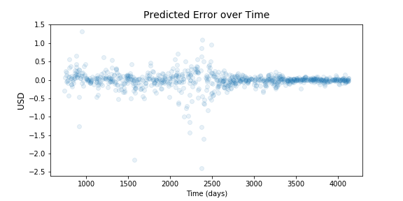
The predictive model is a “Random Forest Regressor”
Model appears to be very accurate:
  “Trained” on the equivalent of approximately 7 years of daily data, randomly selected from 10 years of data
  Tested on the remaining 3 years of data
  With the exception of price shocks, the model predicts average transaction value to within $1 per transaction. (Average transaction values are currently circa $60.)

Slide 6
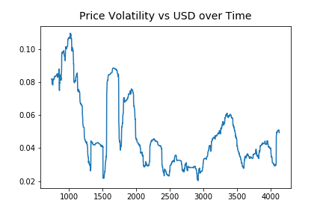
As an aside, BTC price volatility is trending downward
Discovered during model development, this trend implies BTC is becoming less of a speculative instrument, i.e., it is being used more and more as either a n asset or a currency.

Slide 7
Suggestions for Further Model Development
The selection of the data from the dataset intended to represent the target features should be challenged.
Obtain reference statistics for individual or baskets of government issued currencies as well as assets used by the public to store value, e.g., housing and gold. With this data, a classification model could be developed.
The features input into this model do not have the ability to distinguish between small investment transactions and purchases of goods and services. Data that could help to distinguish between these two should improve the validity of the model's conclusions.
This model does not include trends in consumer usage of USD. Adding this trend information or perhaps measuring this data against a basket of currencies rather than USD alone should improve the validity of the model's conclusions
The source data is end-of-day time-series; this model ignores time. Analysis of trends in time could add predictive value.

